Slide 1
Welcome to the ER/CalWORKs Webinar!
You should have a panel on the right of your screen that shows other attendees and has a box at the bottom to write questions. If you can’t see the panel, you can click the orange arrow in the top right corner.
Please practice using the question box. If you could visit any country, where would you go? You can type your answer in the “question” box and hit enter.
Notes:
Before 9:00am (Login at 8:45am)

Slide 2
Partnering at the Intersection of Emergency Response & CalWORKS
Linkages Shared Learning Webinar #5
May 8, 2012
with Leslie Ann Hay of Hay Consulting
Notes:
Welcome comments, Danna introduces LAH, the technical details of our webinar are in the capable hands of Cathy Murnighan
9:00 – 9:05 (2-3 minutes 1st of 2 slides)

Slide 3
Agenda
Emergency Response & CalWORKs An overview of the opportunities and challenges for coordinating services at the point of intake
Linkages as a Prevention Strategy Successful innovations presented by several counties
Maintaining Coordination Focusing on the handoff from ER to FM or FR
Follow-up Opportunities Plus next steps
Notes:
9:00 – 9:05 (2-3 minutes 2nd of 2 slides)
This agenda was built by all of your great responses to the January Survey Monkey…Specifically, people wanted to learn more about:
The opportunities & challenges for coordinating services at the point of intake
How Linkages can work as a prevention strategy to strengthen families
What are ways to tighten up maintaining coordination after the case moves forward from ER to ongoing services.
We’ll be referencing the Linkages Toolkit in all segments of the webinar.
We’ll be highlighting the experiences of some specific counties who are acting as Peer Advisors.
We’ll also have some open-ended time for your questions and sharing idea.
Finally, we want to consider if this is a topic for a clustered interest group or some other mechanism for peer learning.

Slide 4
(
)
Emergency Response and CalWORKs
Emergency Response
Point of Crisis
CalWORKs
Need for economic self-sufficiency?
Need
for family support
service?
Agree to ongoing service coordination?
Prevention
Prevention
Maintaining Coordination
Notes:
9:05 – 9:10 (5 minutes)
Here is the ER/CalWORKs point-of-entry where families become known to either CalWORKs or Child Welfare Services. This graphic depicts the nature of opportunities and challenges for Linkages service coordination at the intersection of ER & CalWORKs. There are essentially 3 ways through which families can access Linkages at the beginning of their involvement in one or both systems:
First, CalWORKs & ER workers may work together at the point of crisis when mutual families are served through one-time coordination between ER & CalWORKs as part of creating a safety net during ER. Example, having a CalWORKs worker may participate in Safety Planning Meetings to find cash assistance, housing, employment or other resources. This coordination may end with the closure of the ER referral or it may be continued as the family is promoted to an ongoing child welfare case. (CLICK for prevention pathways to appear)
Offer prevention strategies for poverty reduction when the family becomes known to ER first.
Apply prevention strategies for family support when the family becomes known to CalWORKs first.
(CLICK for maintaining coordination pathway to appear)
4. Later in the webinar we’ll look at the challenge of continuing coordination beyond the “Point of Crisis” for mutual cases that transfer to ongoing services. But first, let’s dive a little deeper into some Linkages prevention practices…

Slide 5
PREVENTION: ER Point of Entry
Emergency Response
CalWORKs
Need for economic self-sufficiency?
Screening Tool
Integrate with DR
Notes:
9:10 – 9:15 (5 minutes; 1 of 3 slides)
Families are served better when agencies use their knowledge of each other’s programs as a preventive tool, especially with child welfare’s brief encounters with families where needs are evident, but risk is not sufficient to open an ongoing case. Many counties said they were interested in using Linkages to help strengthen families in these situations.
There are several ways that Linkages counties are working together to bring the economic support tools of CalWORKs to families referred to Child Welfare Services. For example:
Los Angeles and San Luis Obispo each have developed brief assessment tools to screen for potential eligibility to CalWORKs programs when poverty appears to be a risk factor for families. Los Angeles’ screening process can be found on the Toolkit…

Slide 6
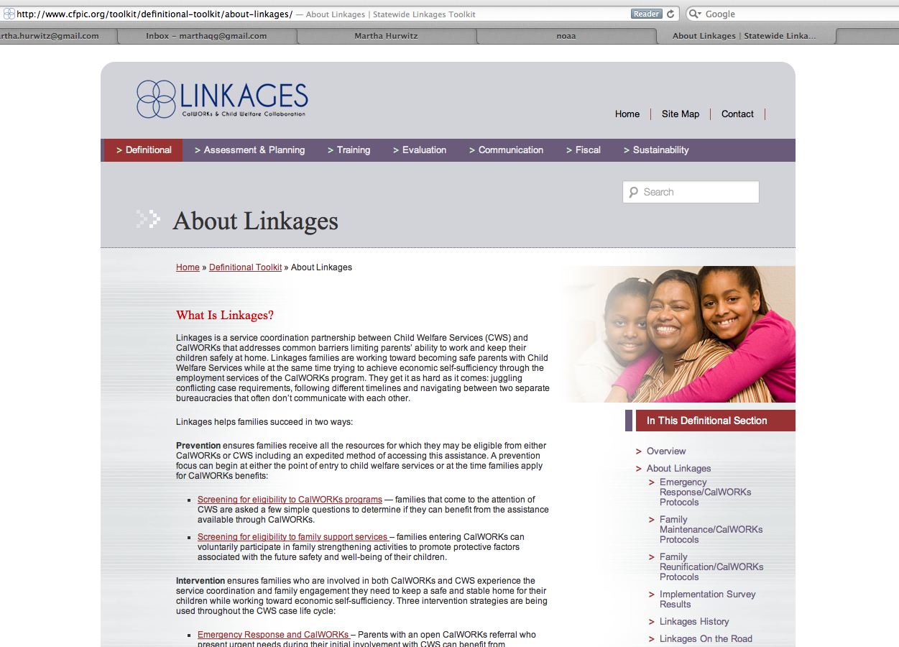
Notes:
9:10 – 9:15 (5 minutes; 2 of 3 slides)
On the Definitional Toolkit, if you look at the About Linkages page, you’ll find a link (click) to some examples of “Screening for eligibility in CalWORKs programs”. If you click there, you’ll be led to a page with some information from Los Angeles about the Screening Tool they’ve developed.

Slide 7
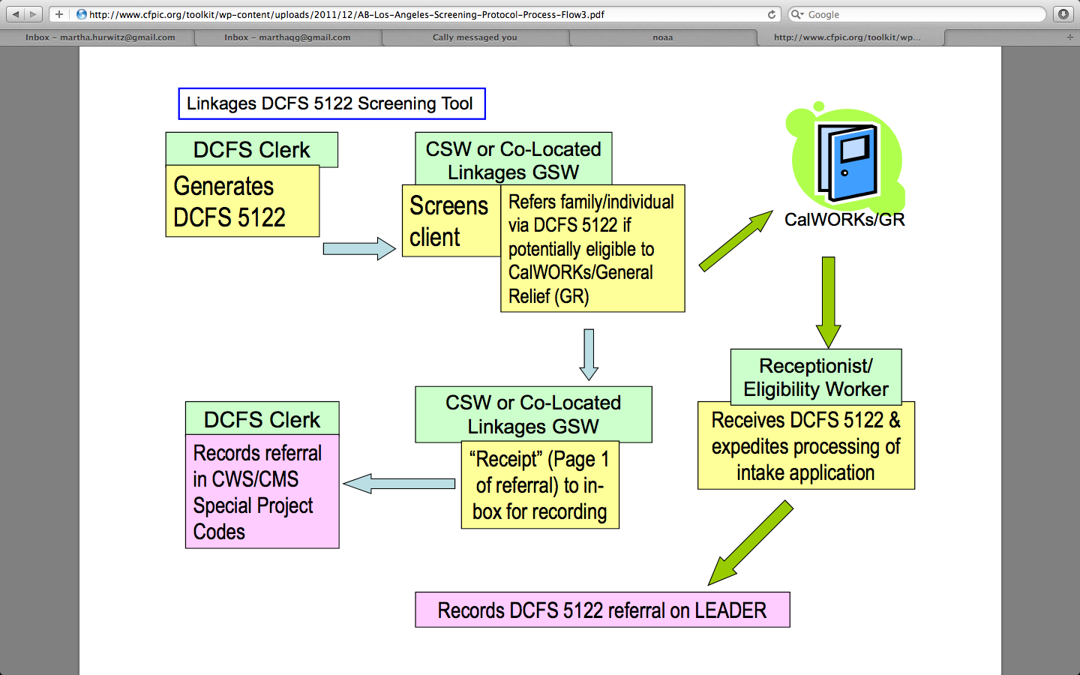
Notes:
9:10 – 9:15 (5 minutes; 3 of 3 slides)
There’s a flow chart that lays out the roles and tasks for both CWS and CalWORKS workers. Ultimately, a family who is deemed potentiality eligible receives expedited processing of their intake application. Whether the family continues as a child welfare case or not, this strategy can prevent family instability situations from deteriorating while families work their way toward economic self-sufficiency.

Slide 8
PREVENTION: ER Point of Entry
Emergency Response
CalWORKs
Need for economic self-sufficiency?
Screening Tool
Integrate with DR
Notes:
9:15 – 9:25 (10 minutes; 1 of 4 slides)
Other counties are looking at integrating Linkages into their Differential Response programs. We have a representative from Orange County on the Webinar today to share how they are approaching this prevention strategy in their location. Let me turn it over to Christine Smith from Orange County’s Child Welfare Services division to tell you more…

Slide 9
Orange County: Linkages & Differential Response
Differential Response offers an alternative response (Path I, II, and III) to allegations of abuse based on the Risk level of the family.
Orange County’s DR Project is… a Community and Agency response based on the tenet that child abuse is both an Agency and a community concern.
Notes:
9:15 – 9:25 (10 minutes; 2 of 4 slides)

Slide 10
Differential Response Path 2
The DR Units have full time SSWs that investigate child abuse reports and partner with other agencies ( Cal WORKS and FRC’s) to provide services.
Orange County’s DR Model incorporates CFS workers co-located with CalWORKS staff in each region of the county to better collaborate and consult on mutual client cases. (DR SSW’s partner and do joint home visit with CalWORKS and FRC staff).
All DR clients are assessed for eligibility to CalWORKs.
DR SSW collaborate with CalWORKS case workers to ensure services are provided. DR SSW’s also participate in meetings related to services for the families
DR families tend to score at the Moderate Risk level using Structured Decision Making (SDM).
Notes:
9:15 – 9:25 (10 minutes; 3 of 4 slides)

Slide 11
Outcome Measurements
The DR Practice Model seeks to reduce recurrence of maltreatment by engaging clients early on in the investigative process and linking families directly to services in the communities in which they live.
Recurrence of Maltreatment is measured by what percentage of families with a substantiated referral did not receive a subsequent substantiated referral within 6 months.
The DR Teamed response is yielding a 70% client engagement rate.
In 2011 DR has worked 2802 referrals.
The DR team model data shows that families do return to community agencies for services.
Notes:
9:15 – 9:25 (10 minutes; 4 of 4 slides)

Slide 12
PREVENTION: CalWORKs Point of Entry
Emergency Response
CalWORKs
Need
for family support
service?
AGREEMENT
Provide voluntary family support services
Notes:
9:25 – 9:35 (2 minutes; 1 of 8)
Now let’s look at the situation when someone comes to CalWORKs to apply for cash assistance, but factors exist that indicate the family could also benefit from receiving family support services. In this situation, familiarity with family strengthening services on the CalWORKs side helps mitigate potential risk factors.

Slide 13
Orange County: Family Support Prevention Services
CalWORKs intake staff trained to engage families in prevention services.
A slideshow about the strategy is housed on the Linkages Toolkit…
Notes:
9:25 – 9:35 (10 minutes; 2 of 8 slides)
In Orange County, CalWORKs intake staff are trained in using a assessment tool to identify and engage families who may be in need of family support services.
Once again, the Linkages Toolkit features information about this Prevention Strategy…

Slide 14
Notes:
9:25 – 9:35 (10 minutes—3 of 8 slides)
On the same page we showed you before--Definitional Toolkit, About Linkages page--you’ll find Orange County’s information on this (click) link “Screening for eligibility in family support programs”.

Slide 15
Notes:
9:25 – 9:35 (10 minutes—4 of 8 slides)
Here to spend a few minutes telling us about this Prevention Strategy is:
Ray Gallagher, Deputy Director, of Orange County Social Services Agency
or
Stephen Schrieber-Smith, CalWORKs East Region

Slide 16
Orange County: CalWORKs SDM Prevention Services
Goals:
Identify family risk factors that indicate the possibility of future child maltreatment
Determine services to be provided to prevent child maltreatment
Increase the ability of the family to engage in employment services and achieve self-sufficiency
Notes:
9:25 – 9:35 (10 minutes—5 of 8 slides)
If there is additional information about the Family Support protocol, it would go here.

Slide 17
CalWORKs SDM Objectives
Identify both family strengths and needs
Offer voluntary Prevention Services to families at risk using reliable & valid assessment tools
Target services to families most at risk and develop case plans using MDT
Prevent the family from future referrals to CPS
Increase the family’s engagement in employment services & WtW participation
Notes:
9:25 – 9:35 (10 minutes—6 of 8 slides)

Slide 18
CalWORKs SDM Outcomes
Families with prior Child Abuse Reports (CAR) & scored high risk on SDM were most likely to volunteer for prevention services (PVR).
Families with prior CAR who received PVR more likely to not have subsequent CAR.
At follow-up, half of families who participated had closed WtW cases, remainder were in DASU, exempt or sanctioned.
Notes:
9:25 – 9:35 (10 minutes—7 of 8 slides)

Slide 19
CalWORKs SDM Outcomes (cont.)
From ‘09 – 11, family agreement to be screened tripled (7% → 24%); up to 40% in 2012
Families who were offered prevention services typically accepted
85% of families moved down at least one risk level: from very high to high, from high to moderate, or from moderate to low
Notes:
9:25 – 9:35 (10 minutes—8 of 8 slides)

Slide 20
Q & A
Questions for Orange County?
What other prevention innovations are you putting into place for either point of entry?
Notes:
9:35 – 9:45 (10 minutes)
Open lines for Q & A.
Prompt counties: SLO?

Slide 21
MAINTAINING COORDINATION
Emergency Response
CalWORKs
Agree to ongoing service coordination?
Coordinate services for the duration of the mutual case
Notes:
9:45 – 9:50 (5 minutes)
More than any other topic, counties identified Maintaining Coordination When Cases Transfer as a challenging area.
Three main areas of focus:
- Continuity of information & knowledge about the case
- Tracking and communicating worker assignment changes
- Centralizing documentation

Slide 22
County Examples: Sharing best practices
Los Angeles – automation & centralization helps with maintaining coordination
Tulare – joining forces to establish a working partnership increases investment in maintaining coordination over time
Questions?
Notes:
9:50 – 10:10 (20 minutes)
We have a couple of counties who have agreed to share their experiences with maintaining coordination. They will provide a brief description of the challenge, the solution and notable observations about how it’s working.
Let’s first hear from Los Angeles, who has used automation and centralization to help maintain coordination during that critical handoff from ER to ongoing Family Preservation Services for mutual clients. We have Alma Vega from the Dept of Public Social Services to tell us more…
Wrap Up LA by 10am
Next, Tulare has learned a lot about maintaining coordination from their joint outreach to mutual clients during voluntary FM…now they would like to move this up earlier to the ER process and utilize the TDMs to strengthen coordination between workers. Let me turn it over to Karen Hansen, Linkages Coordinator from CalWORKs in Tulare County.
Are there any questions for either of these counties before we go on?

Slide 23
Other experiences to share?
About ensuring continuity of information & knowledge about the case?
On tracking & communicating worker assignment changes?
Regarding centralizing documentation?
Other issues?
Notes:
10:10 – 10:20 (10 min)
We wanted to reserve a little time here toward the end to see if any other counties have different experiences to share about maintaining coordination…it can be about the 3 themes mentioned in the survey that we discussed earlier or other issues. Just raise your “hand” and we’ll open up the mic to you.
[If no one comes forward and there’s still time, prompt for any other ER/CalWORKs experiences anyone would like to share.]

Slide 24
Wrapping Up—or Continuing—the Conversation
There’s one more Webinar about ER/CalWORKs in October.
Would you like to participate in an ER/CalWORKs interest group? Use raise hand feature now or email leslieann@hayconsulting.org by Monday, May 14.
What frequency/structure works best for those who are interested?
If you have best practices to include in the Linkages Toolkit, submit them to danna.fabella@cfpic.org
Notes:
10:20 – 10:27 (7 minutes)

Slide 25
Follow Up: we’ll email with…
Copy of this PowerPoint
Updated Linkages Coordinators Directory
Webinar Schedule 2012
Next Webinars
June 5: Family Reunification/CalWORKS
Cathy Murnighan will send registration link
Questions?
danna.fabella@cfpic.org
Notes:
10:27 - 10:30 (3 minutes)

