Slide 1
Welcome to the
Sanctioned Families Webinar!
The panel on the right of your screen shows other attendees and has a Question box below. Can’t see the panel? Click the orange arrow in the top right corner.
While you’re waiting…
What’s the most recent video or movie you’ve seen?
Type your answer in the “question” box and hit enter.
Notes:
Before 9:00am

Slide 2
Helping Sanctioned Linkages
Families Succeed:
Best Practices from the Field
Linkages Shared Learning Webinar #8
December 4, 2012
with Leslie Ann Hay of Hay Consulting
Notes:
9:00 – 9:05 (5 minutes 1 of 2 slides)
Welcome comments, Danna introduces LAH, technical details if any (introduce Cathy)

Slide 3
Agenda
Sanctions Basics
An overview of what sanctions are and how sanctioned families interact with Linkages
Examples From the Field
Innovations by Imperial and Tehama counties
Open Forum
Other counties share about working with sanctioned families
Looking Ahead
A head’s up for what’s in store for Statewide Linkages in the coming year
Notes:
9:00 – 9:05 (5 minutes 2 of 2 slides)

Slide 4
What Is a Sanction?
A sanction is a reduction in a Welfare-to-Work grant exacted when an adult fails to comply with certain Welfare-to-Work requirements
Notes:
9:05 – 9:20am (1 of 4 slides)
add picture of family
add source
add Toolkit Index of Attachments

Slide 5
What Causes a Sanction?
In CalWORKS with WtW
Sanctioned is applied, reducing amount of WtW aid to child-only
An adult in the family fails to comply a requirement, by failing or refusing to:
participate in any assigned program activity
provide required proof that satisfactory progress is being made in any assigned program activity
accept employment
continue employment
continue employment at the same level of earnings
Other issues include failure to:
cooperate with child support enforcement
provide proof of immunizations
Notes:
9:05 – 9:20am (2 of 4 slides)
What causes a sanction?
Here’s our Sanctions 101. We start with a family with an active CalWORKs case and aid from Welfare-to-Work. The adult with the CalWORKs case fails to comply with specific WTW program requirements. These requirements change periodically and may different county to county (LAH, is this accurate?)
When a family, without good cause (and we’ll talk about this more in a minute), does not comply with program requirements, the family’s grant is reduced to remove support for the noncompliant adult (or adults), leaving a “child-only” grant.
State law does not establish a set time period for sanctions to be in effect, although there are statutory requirements that counties must follow when implementing sanctions.

Slide 6
What Cures a Sanction?
In CalWORKS with WtW
Sanction is applied, reducing amount of WtW aid to child-only
Adult can show good cause to cure the sanction
When all requirements are met, adult can contact county for reversal
Following notification of sanction, adult can choose to file an appeal
Notes:
9:05 – 9:20am (3 of 4 slides)
Here we are in Sanctions 102: What Cures a Sanction
There are three possible routes a family can take leading to the cure of a sanction.
Adult can follow detailed notices and follow established appeal process
The adult can address the WtW requirements and ask for reversal of the sanction
The adult can show good cause for exception. This is where Linkages can be helpful with families involved in both CalWORKs and Child Welfare.

Slide 7
Sanctions & Linkages
How are families who are sanctioned or at risk of becoming sanctioned identified?
How do you engage these families through Linkages as a way for them to cure their sanction and participate in needed services?
What kind of coordination process occurs for sanctioned families between CWS social workers and CalWORKs employment specialists?
What collaboration techniques does your Linkages team use to strengthen the support and resources available for sanctioned families?
Notes:
9:05 – 9:20am (4 of 4 slides)
So how exactly does Linkages help families cure their sanctions? Today we have Imperial and Tehama counties here to share their best practices in how they work with sanctioned families. To help focus the presentation, these counties addressed the following questions:
- How do families who are sanctioned or at risk of becoming sanctioned get identified?
- How do you engage these families through Linkages as a way for them to cure their sanction and participate in needed services?
- What kind of coordination process occurs for sanctioned families between CWS social workers and CalWORKs employment specialists?
What collaboration techniques does your Linkages team use to strengthen the support and resources available for sanctioned families?
Let’s start with Imperial. We’ll save time at the end for your questions and comments.

Slide 8
Imperial County
Helping Sanctioned Linkages Families Succeed
Claudia Hawkins, Staff Services Analyst
Elizabeth Wilson, Social Worker III
Patty Ferrel, Eligibility Technician
Notes:
9:20am – 9:40 (1 of 6 slides)

Slide 9
Identifying Sanctioned or At Risk Families:
Imperial County-small Linkages caseload
CWS initiates Linkages referrals and if cases are determined Linkages or meet the criteria, case is scheduled for Linkages appointment in the following month
WTW SW reviews clients past and present participation before Linkages appointment
Meeting consists of the following: Client, Eligibility Technician, WTW Social Worker, CWS Social Worker and Linkages Coordinator
Notes:
9:20am – 9:40 (2 of 6 slides)

Slide 10
How do we engage these families with Linkages to cure their sanction and participate in needed services?
If the case is identified as family maintenance (FM) or volunteer FM (VFM), the WTW SW will work with the client to include all the activities required by CWS in the WTW plan
SW will add other WTW activities in the WTW plan to complete the 32/35 hours required by CalWORKs WTW
This allows the WTW SW to count all the activities the Linkages client is participating in, which can help the client avoid sanction
This allows WTW SW to provide supportive services to client
If children have been removed from the home (Family Reunification-FR), Linkages clients are offered the same services as FM/VFM clients
If a client was sanctioned prior to removal of children, he/she can sign a WTW 29 plan (Plan to Stop a WTW Sanction); if client complies, the sanction is lifted
Notes:
9:20am – 9:40 (3 of 6 slides)

Slide 11
What coordination occurs for sanctioned families between CWS Social Workers and CalWORKs ETWs?
The process is the same to that of any other Linkage case. There is no distinction between sanctioned and non-sanctioned cases.
Notes:
9:20am – 9:40 (4 of 6 slides)

Slide 12
How does your Linkages team collaborate around support and resources for sanctioned families?
Communication
Monthly Meetings with Linkages Team and clients
Linkages meetings are on Tuesdays at 3 different locations
  Calexico - second Tuesday of the month
  El Centro - third Tuesday of the month
  Brawley - fourth Tuesday of the month
Linkages Coordinator sends appointment letters to the staff & clients.
The Linkages staff coordinates services to avoid duplication of services and to ensure that the clients are receiving any needed supportive services to help them succeed and comply to avoid a sanction or cure a sanction.
Notes:
9:20am – 9:40 (5 of 6 slides)

Slide 13
Questions & Comments
What questions or comments do you have for our Imperial County representatives?
Notes:
9:20am – 9:40 (6 of 6 slides)
Thank you Imperial. We have just a few minutes. Let’s open the lines and see if there are questions from the other counties about Imperial’s presentation.

Slide 14
Tehama County
Helping Sanctioned Linkages Families Succeed
LaDeena Coates, CalWORKs Employment & Training Worker
Notes:
9:40– 10:00am (1 of 7 slides)

Slide 15
How are families who are sanctioned or at-risk of becoming sanctioned identified?
Account Tech runs a report of WTW sanctioned cases vs. open cash aid cases
The designated TLC ETW gets a list of scheduled TDMs
The designated TLC ETW attends Path 1 Meetings
TLC screening Form
Notes:
9:40– 10:00am (2 of 7 slides)

Slide 16
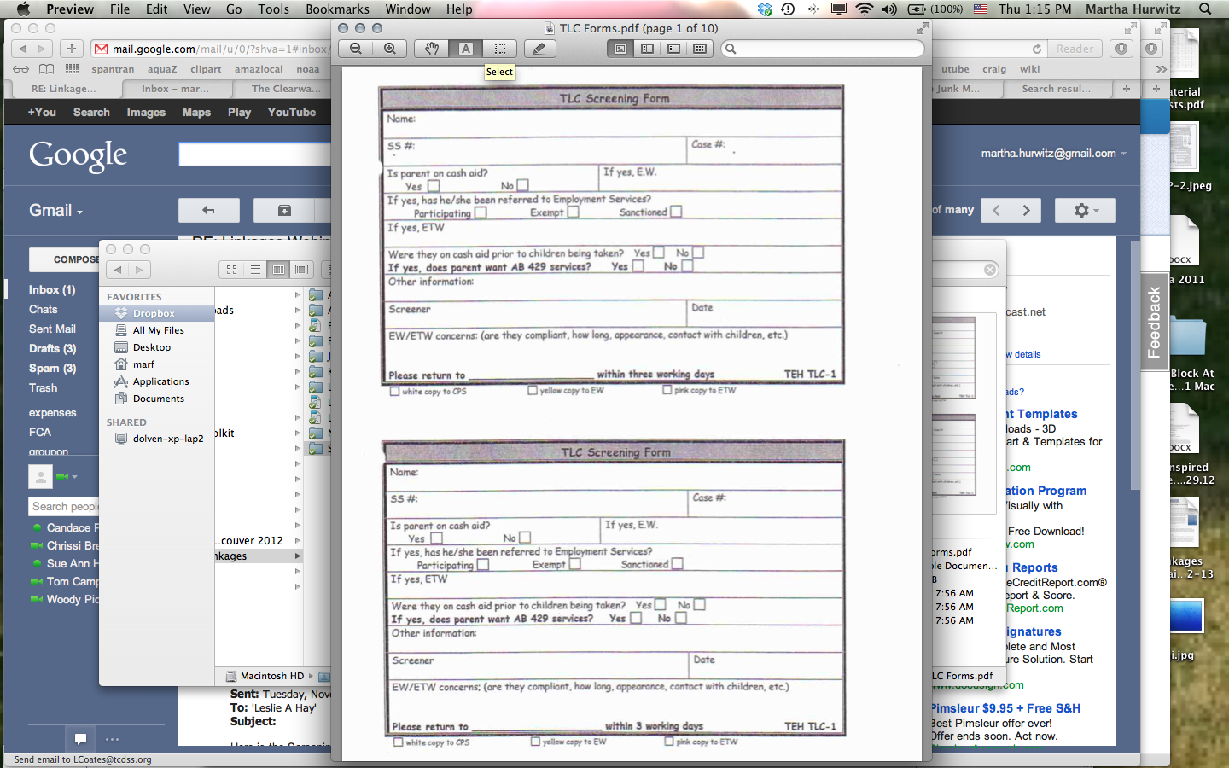
Notes:
9:40– 10:00am (3 of 7 slides)

Slide 17
How do we engage these families with Linkages to cure their sanction and participate in needed services?
When families are identified through Path 1 referrals, home visits are made by the designated TLC ETW.
  Look for red flags in the home
  Talk on their turf
  Make connection with the family
  Discuss the benefits of TLC/AB429 vs GA
Social Workers will encourage families to participate
  Give brochure explaining benefits of TLC
  Discuss the benefits of curing a sanction
Notes:
9:40– 10:00am (4 of 7 slides)

Slide 18
What coordination occurs for sanctioned families between CWS Social Workers & CalWORKs ETWs?
The social workers and ETWs discuss and complete the TLC fiscal case plan
Workers share appropriate case plans and pertinent information concerning the families
Notes:
9:40– 10:00am (5 of 7 slides)

Slide 19
How does your Linkages team collaborate around support and resources for sanctioned families?
Designated Account Tech reviews TLC Fiscal Case plans to prevent duplicate services
Expedited Intake for TLC/AB429 clients
Notes:
9:40– 10:00am (6 of 7 slides)

Slide 20
Questions & Comments
What questions or comments do you have for our Tehama County representatives?
Notes:
9:40– 10:00am (7 of 7 slides)
Thank you Tehama. We have just a few minutes. Let’s open the lines and see if anyone from a different county has a question.

Slide 21
Discussion Questions
What other approaches does your county use to help sanctioned Linkages clients?
How is your county tracking data to show the impact of helping sanctioned families?
Notes:
10:00am – 10:20am (20 min)
Changes questions to these:
You’ve heard from Imperial & Tehama on how they’re doing outreach to Sanctioned families be more successful. Now we’d like to hear if there are other ways that other counties out there are managing meeting the needs of sanctioned families. Do any of you have approaches different than Imperial and Tehama?
Are you tracking, evaluating or analyzing your data with respect to sanctioned families that help you make the case for improving families lives?
[after discussion]
I’m going to hand the mic over to Danna for the last couple of slides.

Slide 22
It’s Been a Great Year
This is the last of 10 webinars in 2012! What are your reflections?
What’s on the horizon for 2013…
Help us keep the Coordinator Directory current
Notes:
10:20 – 10:30am (1 of 2 slides; 10 min)
[Danna takes over]
This concludes the final Shared Learning Webinar of 2012. This was our 8th webinar! We hope you’ve found them informative, inspiring and clarifying. (If time, ask for reflections; if anyone’s been to all of them, etc.)
There is a Shared Learning Plan in the works for 2013: it will include quarterly webinars as well as quarterly discussion forums (a more informal opportunity for counties to get together and discuss a topic of common interest). We’ll be conferring with the Linkages Coordinatorss in mid January to confirm the Shared Learning Plan and decide on particulars; afterwards, they’ll share the overall schedule with staff at the counties.
Please make sure to let us know if your county will have any changes to your Linkages Coordinators. The LCs will be the key to sharing the Plan with the counties, we need to know who they are!

Slide 23
Follow Up: we’ll email with…
  Copy of this PowerPoint
  Updated Linkages Coordinators Directory
Questions?
  danna.fabella@cfpic.org
Notes:
10:20 – 10:30am (2 of 2 slides; 10 min)

