Slide 1
Many Cultures, One People
A deep dive into the experiences of Latinx families in the child welfare system and using the CPM to forge a better path
SESSION 3 of 3
Notes:
Stuart
9:00
Welcome our Third webinar in the series of three webinars designed to provide a rich and expanded understanding of the “thrivance” within and across the many Latinx cultures, including the history and experiences of Latinx families who interface with child welfare, and to create a forum for sharing practice and leadership ideas that cultivate increased effectiveness.
We will be working to infuse what we have learned across all 9 of our REDI webinars into the values, foundational framework, and practice and leadership components into CPM
You are an important contributor today, so welcome! Please engage when prompted—chat, breakout sessions, etc.

Slide 2
Housekeeping
Everyone should be muted except for the designated speakers
Please direct questions and comments to the chat. We are monitoring chat activity and will address questions and comments as needed. Check the chat for the CPM Practice and Leadership Behavior document as well.
Registrants of today’s session will receive a follow up email that includes this Powerpoint, related documents and a link to the recorded session.
If you identify as a part of a certain Latinx culture (Latinx, Hispanic, Cuban-American, etc.), we invite you to change your name using the three dots on your video square to reflect that.
Notes:
Stuart–9:05 (2 of 2)
Drop CPM behaviors into chat. Ask folks to listen for them as we hear from our counties

Slide 3
Why Latinx?
Notes:
Virginia–9:05-9:10 (1 of 3)

Slide 4
Learning Objectives
To understand the history, oppression of, and differences within Latinx populations.
To use data to anchor meaningful stories of Latinx groups in the U.S. and their experiences in child welfare.
To value meaningful behavioral changes at all levels to sustain a healthy organizational culture and climate that lifts up the voice of the Latinx community.
To reinforce the role of leadership to use CPM as the vehicle to improve the experiences and outcomes for Latinx children and families engaged with the child welfare system.
Notes:
Virginia–9:05-9:10 (2 of 3)
We are going to lift our lens today to the voice of families; to those who we must center, but so often miss as we reflect on our practice and our outcomes. CPM calls us to seek out the voices, experiences, and stories of our families regularly and often.

Slide 5
Many Cultures, One People Latinx Workgroup
Virginia Rondero Hernandez
Barry Johnson
Gary Taylor
Judy Webber
Anita Barbee
Jorge Cabrera
Kate Acosta
Andrea Sobrado
Javi Perez
Wanjiru Golly
Amy Rivas
Sylvia Deporto
Eva Ortiz
Notes:
Barry–9:10-9:12
Add all members of the Latinx workgroup—Javi, Virginia, Jorge, Amy, Judy, Sylvia, Gary, Eva, Mia, Anita, Wanjiru, Kate, Andrea (anyone missing?) Barry turns over to Javi

Slide 6
Agenda Review
Spotlight on the teaming and engagement strategies of: Tulare, San Diego and San Francisco
Break
CPM as a vehicle for promoting Race Equity across all social contexts (e.g. race, class, ability, gender identification, sexual orientation), Diversity, and Inclusion
Breakout Session
Share and celebrate our commitments
Notes:
Javi–9:12-9:15 (1 of 2)

Slide 7
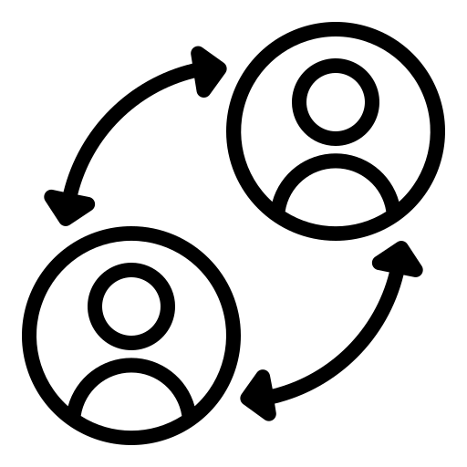
CPM Practice Elements
Engagement
Inquiry & Exploration
Teaming
Accountability
Advocacy
Notes:
Javi–9:12-9:15 (2 of 2)
Review the CPM Practice Behaviors that anchored Webs 1 and 2. Ask people to open up their document from chat to have them handy. Javi turns over to Judy

Slide 8
The Lucero Family
Monica engages the parents via phone, texts, in person, after hours for about a week specifically to support the parents to develop a plan for discharge that felt safe for the family as a whole.
She engaged providers already working with the family to bring resources together and wrapping around the family
Monica facilitated a moment of healing between a father and his child
We were able to secure a hotel for 4 days to facilitate a safe and slow transition home
Notes:
Judy—9:15-9:20
Judy will bring us more “narrative/quotes” for the slide. Similar to “stories from the field” which will bridge us back to webinar 2 before we get going with webinar 3’s content. Say something like, “We highlighted effective practice and leadership from Monterey and Ventura during the last webinar. Today we will continue forward to families and hear as directly as we can more perspective, more stories from three different counties in 3 regions of CA so that we could lean in more to stories of lived experience from a diverse and variety of contexts. Our intention today is to feature leadership at all levels, from the child welfare staff and partners to those who can make systemic changes to ensure that all the ingredients for quality engagement, teaming, and advocacy are linking together and revolving around improving Latinx family experiences.”

Slide 9
The Rodriguez Family
Monica listened closely to the mother as she shared her story, struggles and fears
She supported the mother to secure interpretation services with BHD so that there was no miscommunication and became a liaison between the mother and the treatment team (VCBH)
She told us how much she appreciated Monica’s kindness, good heart and absence of judgement
The mother added that her previous experience with us was “different” but said that Monica gave her the courage and renewed home to tur to the agency for help and support
Notes:
Judy (2 of 2) from 9:15-9:20
Then introduce Kate to hear more about great work happening in the field, more “stories from the field” that center Latinx families and voice.

Slide 10
Moderated Panel: Family Voice
Tulare Parenting Network
Facilitator: Kate Acosta, CCTA
Panelists: Tammy Cunningham, Parent Partner
Yadira Lopez, Supervisor
Marlan Rodriguez, Social Worker
Courtney Sallam, Child Welfare Director
Notes:
Kate–9:20-9:45 (1 of 2)

Slide 11
Panelist Questions
Please share an overview of the Parenting Network and the goals you strive to achieve?
What do you hear the families say that would be more of a support to them? What would you recommend to Child Welfare leadership to improve social work practice and leadership skills when working with Latinx families?
Share your experience when collaborating with Parent Partners and families?
Why was this program important for you to bring to the agency to support the Latinx families? How does this align with CPM? How will you continue to move this work forward?
Notes:
9:20-9:45 (2 of 2)
Tell us about the Parent Partner Program and its purpose (5 min) Leadership
(Chat response: What do you hear from the panel that might help you center Latinx families’ voice, experience in your own practice? Be thinking…..chat your responses when you are ready)
Parent Partners: what do you see? hear? from Latinx families and how do you support them? What is one thing that you would share with the child welfare colleagues here today who are interested in enhancing their practice and leadership skills when working with or on behalf of Latinx families? (5 min-7 min)
Social worker/sup: How do PP enhance my work with Latinx families? (5 min)
Leadership–what CPM LBs are important to sustain the use of the PP program? Why is this program important for Latinx families in your community? (Leadership) 5 min
Field questions from chat. (3 ish min)

Slide 12
Moderated Panel: Safe Care with Latinx Families
San Diego County & SBCS
Facilitator: Jorge Cabrera, Casey Family Programs
Panelists: Kimberly Giardina, DSW, MSW, County of San Diego HHSA
Danielle L. Fettes, Ph.D., UCSD
Karla Ledesma, LCSW, SBCS
Tandy Perry, LCSW, SBCS
Notes:
Jorge–9:45-10:10 (1 of 2)

Slide 13
Panelist Questions
Please provide an overview of SafeCare, and why did San Diego County decided to amplify their implementation with a focus on Latino families?
What is your experience implementing SafeCare with Latinx families and in centering family voice? How does evaluation data further enhances the story of how SafeCare elevates family voice with Latinx families?
From your leadership standpoint, what have been the lessons learned in the implementation of SafeCare? What will other interested Counties will need to consider if wanting to implement SafeCare?

Slide 14
SafeCare+: An Intervention for Latinx Families Experiencing Violence
& Child Maltreatment
Kimberly Giardina, DSW, MSW, County of SD HHSA
Danielle L. Fettes, Ph.D., UCSD
Karla Ledesma, LCSW, SBCS
Tandy Perry, LCSW, SBCS

Slide 15
Evidence-based, behavioral parent-training program for families at-risk or reported for physical abuse, emotional abuse or neglect
• San Diego County since 2008.
• In-home parenting to families involved with Child Welfare Services.
• Curriculum content: Parent Child/Infant Interaction Module Health Module Home Safety Module
• Services provided 6 - 9 months
SafeCare®

Slide 16
Why expand our in-home parenting curriculum for families involved with CWS?
Family
DV Services
CWS
Overlap of child maltreatment and exposure to domestic violence
Both systems working collaboratively toward shared goals
Healing the parent-child relationship
Removing barriers to accessing services (transportation, childcare, DV services under-funded)

Slide 17
Designed to help parents learn about the qualities of healthy & unhealthy behaviors Empower parents to examine and improve their relationships Personal relationships are not limited to intimate partner relationships Educate how relationships can affect the health and well-being of the parent and child Teach effective communication skills which are designed to improve the quality of their relationship and reduce conflict
The Healthy Relationships Module of SafeCare®

Slide 18
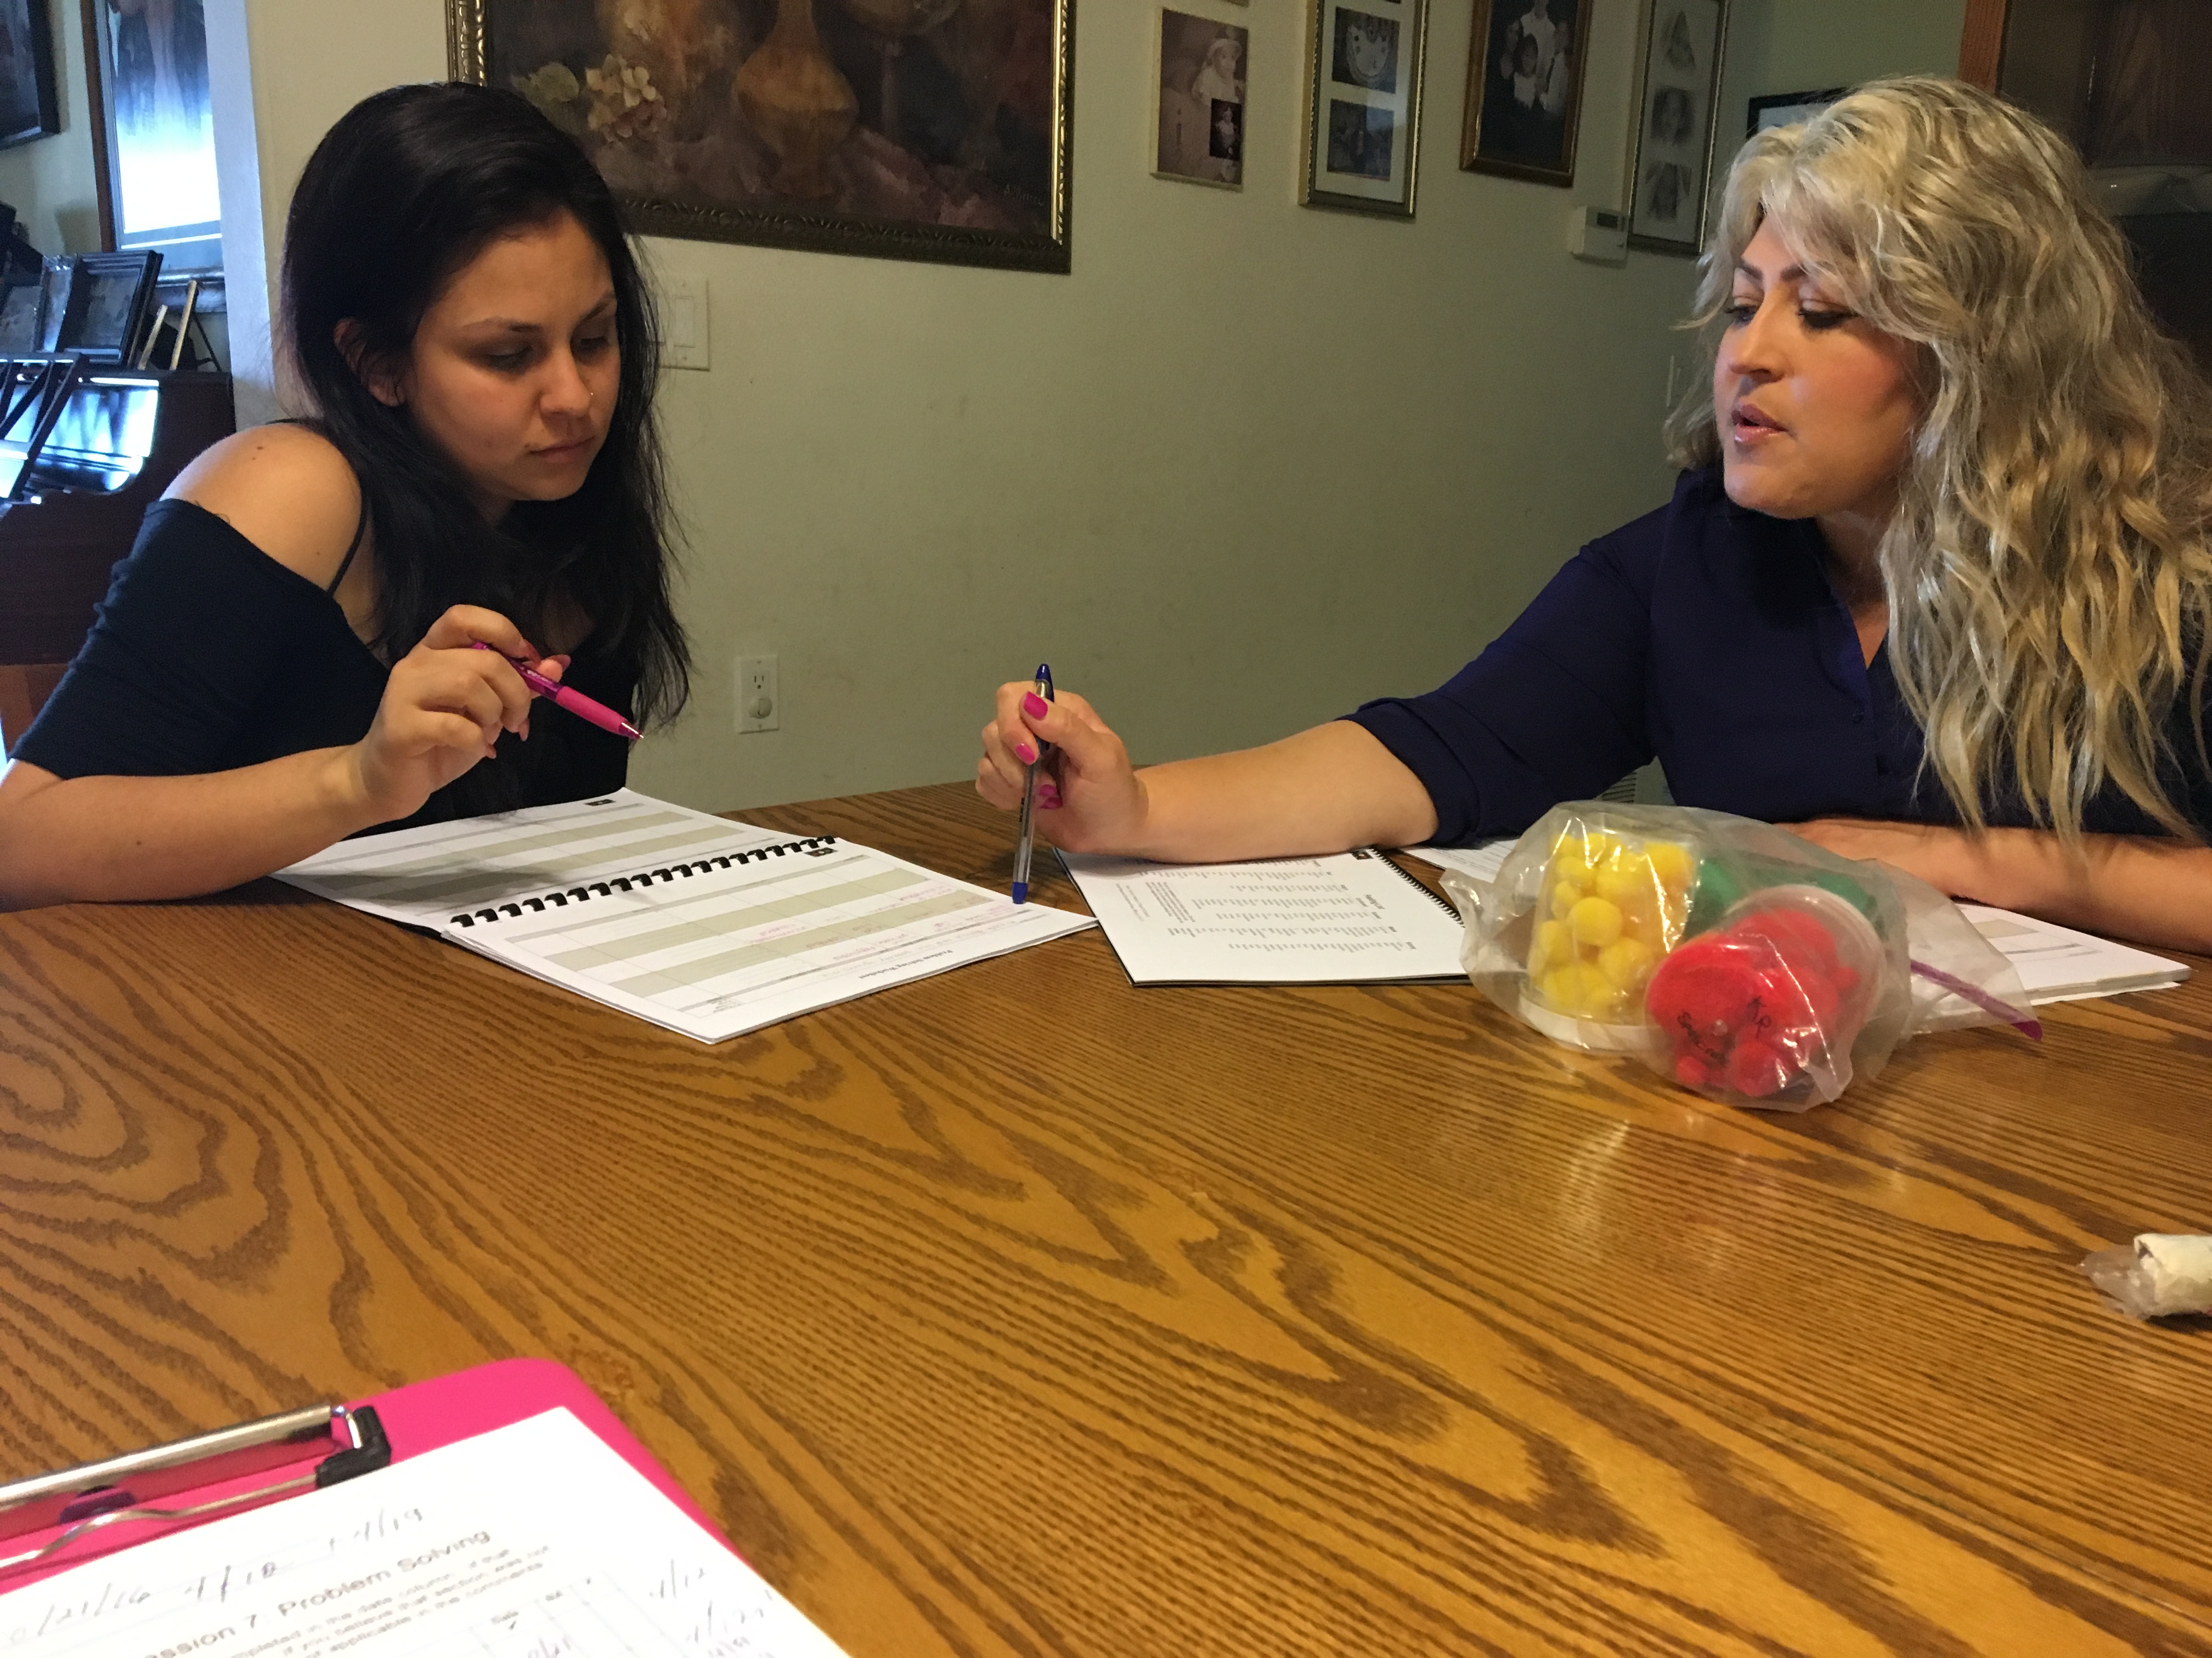
Implemented in the home environment

Slide 19
Trauma-Informed & Culturally-Specific Services
Parent-driven services: which, where, pace
Module flexibility in delivery
Culturally-adapted curriculum, available in Spanish
Staff (ongoing) training, supervision, & coaching
Staff reflect the clients & community
Family members included

Slide 20
Community Needs Assessment
Randomized Control Trial
Feedback Interviews & Focus Groups
We conducted a mixed-method research study to assess the acceptability, fit, & efficacy of Healthy Relationships for Latinx families

Slide 21
IPV in the Latinx Community: Focus Groups
Patterns of IPV are intergenerational
Cultural factors matter
Service Considerations
Contextual considerations
Respect, Understanding, Relatability = Vital

Slide 22
Two partner organizations
Defining Domestic Violence
Screening/Eligibility
Measures/Assessments
Relationship Self-Efficacy
Parent perceptions of change
Conflict-Tactics Scale 2 Short-form
Working Alliance
Satisfaction
Model fidelity
Implementation & Randomized Control Trial of SafeCare+ in San Diego

Slide 23
Healthy Relationships Program:
Parent Characteristics
Average age: 30

Slide 24
Parents who participate in Healthy Relationships report improvements in relationship self-efficacy
To a very great extent
To a slight extent

Slide 25
Parents reported using “negotiation” in current relationships over 80% of the time in past two months
Positive impact is also reflected in reported relationship conflict
And, parents report a reduction in verbal aggression from baseline to completion of Healthy Relationships

Slide 26
Parents who participate in Healthy Relationships report excellent connection with their providers
Always
Never

Slide 27
The majority of parents are highly satisfied with the Healthy Relationships program
To a very great extent
Not at all

Slide 28
Program Satisfaction: In Their Words
“It’s a great class for anybody that has trouble with their relationships, whether it is family or intimate relationships. It’s a great program.”
“The most helpful thing that I have learned (from parenting program) is Healthy Relationships”
“It’s the one thing that should be in the parenting program”

Slide 29
Providers agree that the HR program makes a positive impact on parents’ lives
“Some parents have also shared with me how they recognize previous actions in their current or past relationships that were unhealthy and the module helps them learn how to improve positive communication and have a more healthy relationship”
“Parents have expressed they learned a lot through the Healthy Relationship. For example, (this parent) noted he now understands he slid into his current relationship. By acknowledging this, client allowed himself to try new things to build a better foundation with partner”

Slide 30
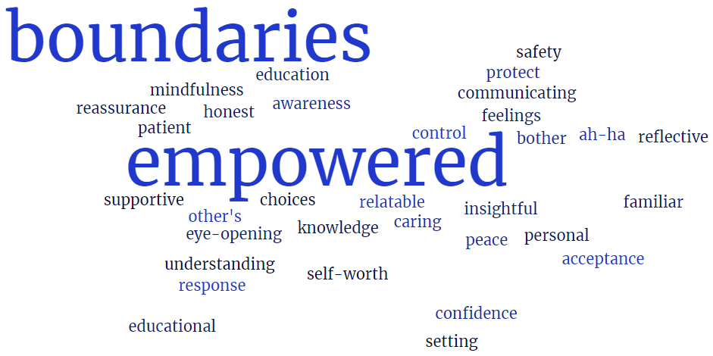

Slide 31
Providers and parents unequivocally think the HR program is culturally relevant
“It’s a good fit for Latinx families” (parent)
“This is very helpful to our clients due to the believes that they have, and what they bring to a relationship” (provider)
“We are prideful… (yes, I would recommend) the program for latin@ families. We have non-healthy relationships” (parent)
“I feel the HR module is culturally sensitive to all types of families and should be made available for all families” (provider)

Slide 32
Today, SafeCare®
with Healthy Relationships is being implemented system-wide in San Diego County

Slide 33
Lessons Learned

Slide 34
Thank you!
Questions?
Kimberly Giardina- Kimberly.Giardina@sdcounty.ca.gov
Danielle L. Fettes- dfettes@health.ucsd.edu
Karla Ledesma- kledesma@csbcs.org
Tandy Perry- tperry@csbcs.org

Slide 35
Moderated Panel: Behaviorally Based Case Plans
San Francisco
Facilitators: Jorge Cabrera, Casey Family Programs
Panelists: Jessica Mateu-Newsome, Program Director of Early Intervention Program
Larisa Rostran-Navarro, Protective Services Supervisor with Supportive Transition
Notes:
JOrge–10:10-10:35 (1 of 2)

Slide 36
Panelist Questions
Please share with us as to the leadership decision to promote the use of Safety Organized Practice as a framework to enhance practice with Latinx families in San Francisco?
As a social worker who directly works with Latinx families, can you share with us as to how have you seen SOP tools add significant value to your work and in centering family voice?
From your leadership standpoint, what have been the lessons learned in the implementation of Safety Organized Practice with Latino families? What lessons have you learned that other Counties can consider in using and enhancing their SOP practice with Latinx families?
Notes:
10:10 – 10:35

Slide 37
INCORPORATING SOP PRACTICE AND FAMILY VOICE WITH THE LATINX COMMUNITY
San Francisco County Panel
Jessica Mateu-Newsome, Program Director of Early Intervention Program
&
Larisa Rostran-Navarro. Protective Services Supervisor with Supportive Transition
June 29, 2022

Slide 38
Why leadership decision to promote SOP as a framework to enhance the practice with Latinx families in SF?
Main belief is that all families have strengths
Meeting the family where they are
Partnerships/teaming are key to ensuring safety, permanency and well being
Being culturally humble- understanding the cultural values, effects of immigration and acculturation, being culturally competent, culturally appropriate services

Slide 39
Overview of Practice
What differences has the implementation of SOP made in Latinx families?
Focuses on behaviors not services
-Clearly communicating the harm/danger statement & safety goal.
-Parents and social workers know the behaviors we are worried about
and the expected change of behaviors.
Way of Thinking that informs all the stakeholders.
- Develops a common language, purpose & goal.
Set of Principles that guides us
-Families have acts of protection.
-Families can change behaviors.
-Families have and can build their support network

Slide 40
Case Scenario
Mother: 23 y/o Latinx mother also 3-4 months pregnant.
Minor:10-month old female with non-accidental spiral injuries of both tibias, healing fracture to left wrist –unknown how it happen & unknown perp.
Support Network: MGM, MGA, Maternal cousins.
Boyfriend (not the father of the10-month old): 27 y/o Latinx male, 3-4 months new relationship & recently out of prison.
Prior to implementation of SOP No tools to guide. No focus on behavior but rather the person, not knowing who did it. Caution around taking risks. Immediate removal of newborn. Limited family voice. Support of agency and courts about limited or no reunification. | Implementation of SOP Utilization of tools -3 questions tool & solution- focused questions with everyone. -mapping quadrant with family during meetings and CFTs. Coaching session every 2 months behavior changes. Inclusion of family voice. On-going communication about Harm, danger & safety goal statements. Safety planning with newborn. Reunification after 9 months

Slide 41
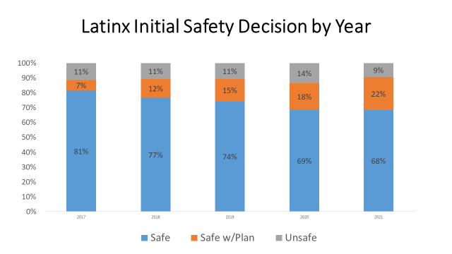

Slide 42
What have been the lessons learned in SF in the implementation of Safety Organized Practice with Latinx families?
Be culturally humble and ability to listen to the family
Importance of being an advocate
Being creative and thinking outside the box
Utilize early adopters
Support coaching and training
Have courageous conversations
Share success
Be aware of youth power

Slide 43
Break: Return at 10:50 am
Notes:
10:35-10:50

Slide 44
CPM is Anchored in Social & Racial Justice
We envision that CPM would be the consistent framework, across all 58 counties, the vehicle that drives all practice and system improvement. By embracing the values and beliefs of the CPM I can respond to race equity issues that are evident in experiences of our families, communities, workforce and partners. The evolving CPM, and implementation of consistent practice behaviors and system improvement are capable of producing more equitable outcomes for the children and families I serve.
CFPIC REDI Workgroup, Summer 2020
Notes:
Andrea–10:50-10:55
Over a year ago, CFPIC began our Race Equity, Diversity, and Inclusion webinar series with the expressed intent to lean in and learn about different cultures and communities of people and their experiences with child welfare so that we could integrate wisdom from lived experience, examples of culturally responsive and innovative practice, and critical tenants of leadership that would ensure them them into our evolving child welfare practice model, CPM. We began our webinar series with a focus upon the history and experience of African American families in child welfare and we examined some ideas and strategies that might counteract structural and institutional racism, followed by a deep dive into the history and experiences of the tribes, Sovereign Nations, of people who have also interfaced with the child welfare system, and the imperative calling upon each of us to carry out ICWA in a way that honors the tribes as Sovereign nations and as an absolute standard from which all interaction must flow. In each of the webinars, we saw that the tenets of effective practice linked completely with the foundational CPM principles, values, and behaviors. The big take away was that our practice model, the CPM, if filtered through a social and racial justice lens, might provide some powerful guidance around diversity, equity and inclusive practice.
Let’s take a look….
The premise is that the use of CPM as a vehicle for change, can help us advance racial and social justice even within the context of child welfare.

Slide 45
Racial Justice in the Child Welfare System:
Leveraging CPM to build a race equity culture
Notes:
Gary, slides 17-21. 10:55-11:00

Slide 47
Underlying Assumptions
Although race has no basis in biology, racism is real
The impacts of racism are pervasive and go beyond direct harm to only people of color
Transformation of our system requires elimination of institutional and structural racism
The language available to us is insufficient to fully capture the experience and impact of racism

Slide 48
Racism operates at 4 levels
Internalized (Personal)
Within individuals
Beliefs & biases, influenced by culture
Internalized oppression / superiority
Interpersonal
Between individuals
Personal prejudice & intentional bias in action
Institutional
Within institutions & systems
Policies & practices that maintain discrimination / oppression
Structural
Among institutions & across society
In human services, collaboration across systems can reinforce racism’s impact
Notes:
Gary
Race Forward model (https://www.cacgrants.org/assets/ce/Documents/2019/FourLevelsOfRacism.pdf)
In the institutional bucket, ”individuals within institutions take on the power of the institution when they reinforce racial inequities.” In other words, we are personally responsible for interrupting institutional racism when we see it happening. It is not enough to not be personally racist. We must actively take on anti-racism as a personal commitment.
In the structural bucket, we’ll see how collaboration across systems can maintain the discriminatory/oppressive status quo when we get to white supremacy culture and bias.
And yet, there is hope, because other human services (self-sufficiency) have divested from surveillance and partnering with systems of punishment (“accountability”).
Also, we currently have a clear policy that we don’t tip off immigration status to ICE (most of the time), so we have already made some decisions to divest from this.
From Aprille: Relational worldview logic models help us to decolonize our thinking by shifting from linear and individual to circular/collective and systems theory (e.g. person in environment)

Slide 49
Lessons Learned 4 Main Factors Facilitating REI Success
Gary Taylor, CPM Faculty
1. Having the commitment and buy-In of leaders throughout the organization and those on the front-line).
2. Being data driven, monitoring and communicating success
3. Investing in efforts to develop leadership and staff
4. Partnering with other entities

Slide 50
Growing and Linking Our Knowledge about Data, History, and Sovereignty to Strengthen ICWA Practice and Leadership Behaviors
Notes:
Sylvia, slides 22-25, 11:00-11:05
Following the first three sessions on racism in the child welfare system and some information about the African American experience we focused on providing a series on the experience of Native Americans.
In partnership with the CDSS Office of Tribal Affairs we developed three sessions That were delivered in the fall of 2022 and early 2022.
Date fix logos
-Kick off SO & land acknowledgement and hand over to Tribal

Slide 51
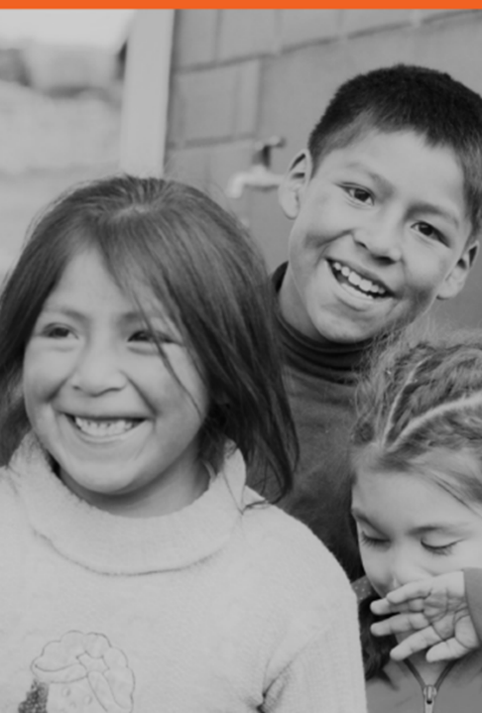
Growing and Linking our Knowledge About Data, History, & Sovereignty to Strengthen ICWA Practice and CPM Leadership Behaviors
Learning Objectives
1. Assess what the current data tells us and does not tell us about the extent of disparities that exist among the Native American children and families we serve.
2. Increase knowledge about the historical context of the Native American experience in the United States and California
3. Introduce more how government laws and practices have shaped and impacted Native American experience, especially as it pertains to children and families.
Notes:
Sylvia- these were our learning objectives for our first ICWA session.
It was important to review the data, or the lack of it, in our current system so that we could better understand the issues of disproportionality and disparity of Native American children in the California child welfare system.
It was also important to understand the historical context of Native American people in our country and the impact that experience had and continues to have on Native people and communities.
Lastly, the importance of having knowledge about the many laws and practices by the United States government that impacted Native American people’s experience in this country, especially children and families (relocation, boarding schools, adoption project…)

Slide 52
Learning Objectives
To learn about the states and counties’ responsibility to engage in a government-to-government Relationship with Tribes in Child Welfare Matters.
To learn about the concepts and features of on-going Tribal engagement and consultation.
To deepen the understanding of the Role of child welfare leadership in the application of the Indian Child Welfare Act.
Notes:
Sylvia-These were the learning objectives we focused on for the second and third sessions of the ICWA series.
The importance of understanding that Tribes are sovereign nations and therefore our interaction with Tribes is in a government to government context. It is a political distinction not an ethnic one.
Tribal engagement and consultation are required to ensure the respect necessary is given to Tribes as sovereign nations.
The ICWA is one way of repairing the damage this country has inflicted on Native American people and child welfare leadership is responsible for ensuring appropriate application at all levels of the agency.

Slide 53
CPM Promotes REDI for Everyone
Notes:
11:05-11:20
Sylvia and Judy to explain that if CPM’s LB and PBs are viewed through the REDI lens, they really do combine together (all the behaviors) to form a foundation for REDI practice. Ask people to give a quick example of REDI practice and then will show how that example could be an illustration of a CPM Bx in operation. These people will have been prepared to give 2 minute short stories…

Slide 54
Breakout Session
What will you do to promote REDI in your own counties?
What might get in your way?
Which CPM behaviors align with your actions (practice or leadership)?
Notes:
Sylvia, send to the breakouts–11:20-11:35, session.
11:35-11:40 chat/reflect (Eva/Amy/VRH)
This is your chance to make some personal commitment to joining the effort to advance race equity, diversity, and inclusion in our own agencies. We hope that the past 9 webinars have provided you with a stronger understanding of the practical ways that CPM can help! Send folks into 15 minute breakout sessions. Folks are invited to drop their “one thing” (response to the Q1) into chat as they return. Reflections here by whoever has this slide.

Slide 55
Poll
Notes:
Andrea or Anita–11:45-11:55
Launch this poll and reflect

Slide 56
Large Session Debrief & Closing Appreciations
CPM is evolving to include REDI into our practice and leadership framework.
Thank you to all of the REI Webinar Design teams and participants.
Learning Session VII will continue the effort of infusing REDI principles into CPM.
CPM Faculty maintain an online resource folder that includes an array of articles and links that can be helpful in addressing racial justice issues.
Notes:
Stuart–11:55-noon
CPM is a vehicle for change, can help us advance racial and social justice even within the context of child welfare.
You are important; your commitment matters; you matter.
none of us can do this alone, but together we can…!

