Slide 1
County-Based Medi-Cal Administrative Activities (CMAA) Program Overview
For Public Guardian Offices

Slide 2




What is CMAA?
The County-Based Medi-Cal Administrative Activities (CMAA) Program provides partial federal reimbursement, passed through the Department of Health Care Services (DHCS), to reimburse Local Governmental Agencies (LGAs) for their costs associated with performing administrative activities that support efforts to:
• Encourage people to apply for Medi-Cal
Help clients find Medi-Cal providers
Assist with Medi-Cal applications
Provide case management to clients for Medi-Cal covered services
Improve the Medi-Cal safety net in our community and access to providers

Slide 3



CMAA Program Goals
Improve services for Medi-Cal beneficiaries in our community
Get more members of our community enrolled in Medi-Cal so they can access preventative healthcare
Provide opportunities for our county and community-based organizations to receive partial reimbursement for activities they are already doing

Slide 4
Reimbursable CMAA Activities
Case Management for Medi-Cal covered services
Making referrals, coordinating and/or monitoring the delivery of Medi-Cal services.
Examples:
Coordinating transportation to Medi-Cal covered services
Helping a client order or refill a prescription
Making a referral for a client to receive a physical examination or mental health service
Talking with other medical professionals about a client’s healthcare needs
Ensuring that services are being provided in accordance with client’s care plan.

Slide 5
CMAA Activity Limitations
Case Management for Medi-Cal covered services
For conservatees residing in a Skilled Nursing Facility (SNF), only monitoring the care plan and ensuring services are being delivered and assisting with Medi-Cal applications is allowable.
For conservatees ages 21-64 residing in Institutions for Mental Disease (IMD), only assisting with Medi-Cal applications is allowable unless:
The conservatee is receiving Substance Use Disorder (SUD) services with a short-term stay of no more than 90 days
The conservatee is receiving Severe Mental Illness (SMI) services with a short-term stay of no more than 60 days
There are no limitations in case management services for conservatees residing in Board & Care, Independent Living, & Adult Foster Care.
The IMD exclusion is a long-standing policy under Medicaid that prohibits the federal government from providing federal Medicaid funds (FFP) to states for services rendered to certain Medicaid-eligible individuals who are patients in IMDs (§1905(a)(30)(B) of the Social Security Act [SSA]). When a Medicaid-eligible individual is a patient in an IMD, the individual cannot receive Medicaid coverage for services provided inside or outside the IMD. The IMD exclusion applies to individuals aged 21 through 64.

Slide 6
Reimbursable CMAA Activities
Facilitating Medi-Cal Applications
Time spent explaining Medi-Cal eligibility rules and processes, assisting with the completion of a Medi-Cal application, gathering information related to the application, and providing proper Medi-Cal forms.
Examples:
Collecting, packaging, and providing all forms in preparation of the Medi-Cal Eligibility Determination
Verifying a client's current Medi-Cal status
Assisting clients with the Medi-Cal appeals process
Gathering additional information for the Medi-Cal application process for clients
Changing counties for Medi-Cal

Slide 7
Reimbursable CMAA Activities
Program Planning and Policy Development to increase Medi-Cal system capacity
Performing activities around and developing strategies to increase Medi-Cal system capacity and close Medi-Cal service gaps
Examples:
The portion of deputy support meetings where focus is on Medi-Cal services
Monitoring Institution for Mental Disease (IMD) or Skilled Nursing Facility (SNF) contracts to ensure required services are being provided
Drafting, editing, reviewing, and gathering data related to the need for additional Substance Use Disorder (SUD) or mental health treatment facilities for conservatees

Slide 8
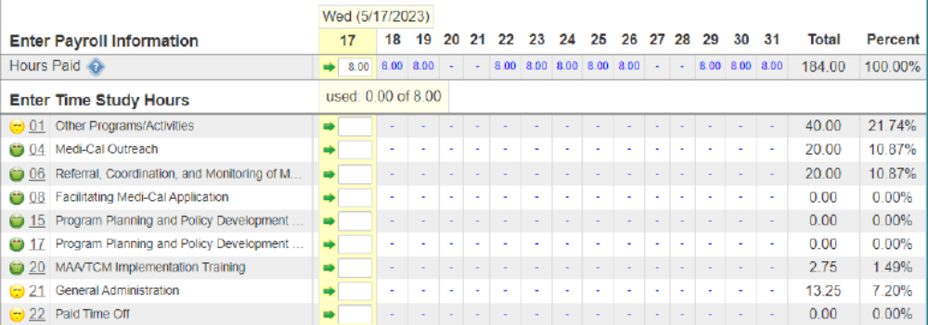
Time Study Process
Example of an Electronic Time Study System
A daily time study is required to allocate hours between reimbursable and non-reimbursable codes.

Slide 9
Who is Eligible to Participate
Staff or Contractors who perform a reimbursable activity (listed in previous slides) and are not funded 100% by federal dollars or state or local dollars required to match federal dollars.
CMAA activities are already occurring at the county and community level and are supported with non-federal public funds. These funds are called Certified Public Expenditures, or CPE.
Local Governmental Agencies or community organizations must first spend these CPE funds on CMAA activities in order to receive federal reimbursement.

Slide 10
Time Commitment
Time Study Participants:
  1.5 hours of initial training & Sign Forms
  Half hour annual refresher trainer
  Complete a daily time study (a couple minutes/day)
  Provide CMAA examples throughout year for audit file

Slide 11
Other Dept. Program Requirements
• Assign a Lead for the Claim Unit
• Help organize Initial Training and Annual Refresher Trainings for each time study participant
• Make sure that monthly time studies are completed for every time study participant (time study reminders)
• Help collect audit file documentation (Signed Duty Statements, Training Logs, and examples of CMAA)
• Prepare client lists for each quarter to verify Medi-Cal eligibility – Name, DOB, and SSN (if available) to submit to DHCS via Secure File Transfer or can use Countywide Medi-Cal Average of XX%.
• Download and save bi-weekly payroll report for payroll verification.

Slide 12
Fiscal Requirements to Administer CMAA Program
• Prepare quarterly invoices. Need:
  Operating Costs
  Salary and Benefits
  Roll Up of Completed Time Survey Results
  Org Charts
  Medi-Cal Rate
• Review all revenues at end of Fiscal Year and match them to the cost pools where staff are charged in the quarterly CMAA invoices to ensure federal revenues are subtracted from reimbursement.
Question: Does your Public Guardian Office track expenses separately from other DSS programs?

Slide 13
Program & Fiscal Support
LGA Can Provide:
• Annual Training and Refresher Trainings as needed
• Preparing and submitting CMAA Claim Plan Documents
• Performance monitoring & coaching
• Uploading payroll verifications
• Time study management
• Invoice preparation and submission
• Audit file documentation review and storage

Slide 14
How much funding will my program get?
Invoice Total =
Time Study Results x Medi-Cal % x (Payroll + Operating Expenses)/2
Minus $XX/time study user or supervisor/quarter
Minus XX% of Invoice Revenue: 2% State Annual Participation Fee and XX% for Program Administration by LGA’s CMAA Coordinator – Invoiced at end of each fiscal year
Notes:
The time study determines the percentage of time spent on allowable MAA activity codes and the Medi-Cal rate discounts the entire invoice to match the rate for the quarter.

Slide 15
Next Steps
Provide time study estimates and costs and revenues from last year to calculate a CMAA revenue estimate
If moving forwards:
  Setting up a new claiming unit takes about 2 months
  Provide data to CMAA Coordinator to create CMAA Claiming Plan for state and set up staff in electronic time study system
  Identify a person to run and save biweekly payroll reports
  Determine if new claiming unit will use actual client data or the county’s average Medi-Cal Rate
  Set up Initial Time Study Training for staff before start of a quarter
  Develop an MOU between LGA and Public Guardian for CMAA Claiming and reimbursement of administrative fee

Slide 16
Questions?
Contact LGA Coordinator
[Name]
[Email]
[Phone #]

