Slide 1

County Medi-Cal Administrative Activities (CMAA)
Program Overview
for
Veterans Services Offices
Notes:
Good Afternoon, everyone. My name is Kristal Baumbach. I am the LGA Coordinator and program manager for Placer’s CMAA program. I am also the Executive Team co-chair on the state’s LGA Consortium for CMAA & TCM. With me today is Debbie Daniel from Nevada County, She helped Placer get our VSO MAA program started and co-presented with Placer VSO staff Eva Jimenez in May at the CMAA/TCM LGA Conference.
Thank you for having us today. We are excited to be here with the California State Association of Veteran Services Officers to discuss County-Based Medi-Cal Administrative Activities, or CMAA, and how these activities can impact the important work you all are doing to serve veterans across the state.
As you know, Medi-Cal provides crucial healthcare support to millions of Californians, including our veteran population. Today, We’ll be walking you through how CMAA can help Veteran Service Program tap into federal funding to support administrative services that assist Medi-Cal beneficiaries. We’ll also explore how these activities might align with the services you already provide and open up new possibilities for further supporting your veteran clients. We will also discuss how CMAA program handles other federal funding sources that you may already receive to ensure that we are not double dipping and claiming the same activities under multiple federal funding sources.
By the end of this session, I hope you'll have a clearer understanding of the CMAA program and how it can benefit your organizations and the veterans you serve.

Slide 2
COVID-19
What is CMAA?
County based Medi-Cal Administrative Activities (CMAA) provides partial federal reimbursement for the cost of performing administrative activities. Example activities include:
Explaining the Medi-Cal program and assisting individuals to enroll
Linking individuals to Medi-Cal services through referral, coordination and monitoring
Program planning, policy development, and interagency coordination of Medi-Cal services
CMAA Program Overview I 2
Notes:
(Kristal)
The County-Based Medi-Cal Administrative Activities (CMAA) program is a federal initiative administered through the Centers for Medicare & Medicaid Services (CMS). Launched in 1995, it provides reimbursement to counties for performing administrative tasks that support Medi-Cal beneficiaries in accessing healthcare. These tasks include explaining the Medi-Cal program, assisting with enrollment, and coordinating referrals to necessary services. CMAA also funds program planning and policy development that improve service access. This program, which operates across the U.S., helps counties recover costs while ensuring individuals, including veterans, receive the care they need.
CMAA is a crucial opportunity for counties to get reimbursed for certain administrative activities that support Medi-Cal-eligible individuals. This funding helps local agencies offset the costs of essential tasks that often go unnoticed but are vital in ensuring that people can access the healthcare services they need.
For instance, explaining Medi-Cal eligibility requirements to veterans and their families and helping them navigate the often complex enrollment process can be reimbursable through CMAA. Veterans often face unique barriers when transitioning from other healthcare systems to Medi-Cal, and your work in bridging that gap is eligible for federal reimbursement.
Beyond enrollment, CMAA supports the critical work of linking veterans to necessary medical care, whether it’s coordinating between different healthcare providers, scheduling appointments, or following up to ensure they’re receiving the care they need. This coordination is not only beneficial for veterans but also reimbursable under CMAA.
CMAA also reimburses for higher-level activities, such as program planning and policy development that improve access to Medi-Cal services. For example, if your office collaborates with other agencies to streamline veteran access to services or to develop new outreach programs, those efforts may qualify for reimbursement.
CMAA is done in many programs throughout the state and it really varies by County. Some Counties like Santa Cruz have over 40 claim units, Placer has 8 and these are seen in programs like - Public Health – Public Health Nursing, Communicable Disease, PH Administration, Public Guardian, Homeless Services, Community Based Organizations, Family Resource Centers, Centers for Independent Living,

Slide 3
COVID-19
Unique Funding Opportunity
The CMAA program provides agencies with unrestricted funding, meaning once the reimbursement is received, it can be used for any purpose that supports your organization's mission and goals.
FY22/23 = Counties brought in over $115 million for CMAA
CMAA Program Overview I 3
Notes:
One of the most attractive features of the CMAA program is that the federal reimbursement received is unrestricted. Unlike many other funding sources that come with strict usage guidelines, CMAA funds offer flexibility. This allows organizations to allocate the reimbursement where it’s most needed—whether it's enhancing existing services, investing in new initiatives, covering operational costs, or increasing staffing levels.
In fiscal year 2022-2023, counties across California brought in over $115 million through CMAA reimbursements. This influx of funding demonstrates the program’s potential to support agencies in ways that are directly aligned with their missions. It’s a unique opportunity that allows you to reinvest in areas that need it most.
If you’re not participating in CMAA, you're leaving money on the table. I think it’s safe to say that most Veterans Services programs already struggle with inadequate funding from the state to meet their needs. CMAA can provide additional resources to help fill these gaps and support your program's objectives.
One thing to note is that this program works differently from typical funding sources. CMAA is claimed in arrears, meaning counties are currently working on claims for fiscal year 2023-2024, with the first expected payments not arriving until June 2025. While there’s a delay, the long-term financial support is well worth the effort.

Slide 4
COVID-19
How can County VSOs participate?
County VSOs must work through their County's CMAA program to participate.
Local Government Authorities(LGAs) (i.e. County CMAA Program) may directly provide services or subcontract with nonprofit organizations or other local public entities providing services within their geographical region
LGA submits claim unit plans to the Department of Health Care Services (DHCS) for approval and invoices to receive reimbursement for CMAA Activities
CMAA Program Overview I 4
Notes:
(Kristal)
For County VSOs to participate in the CMAA program, they must work through their county’s CMAA program, specifically through the LGA coordinator. This is because only the LGA coordinator is authorized to submit claim unit plans and claims to the state for approval and reimbursement. This ensures that all administrative processes align with state requirements.
County VSOs can either directly provide services or partner with nonprofit organizations or other public entities. LGAs have the flexibility to subcontract with community-based organizations that help provide MAA activities to veterans. If you are working with such organizations, they too can be included in the CMAA program to draw down federal dollars.
The LGA coordinator submits claim unit plans to the Department of Health Care Services (DHCS) for approval. After that, the LGA invoices DHCS to receive reimbursement for CMAA activities.
For many County VSOs, this can be a game changer, as it opens up a new funding stream that aligns with the work you’re already doing. Partnering with your county’s program makes it possible to tap into these federal dollars.

Slide 5
COVID-19
Non-Participating Counties
Alpine
Butte
Del Norte
Fresno
Kings
Mendocino
Modoc
San Benito
San Bernardino
Sierra – process of starting
Solano
Tehama
CMAA Program Overview I 5
Notes:
(Kristal) Program could be started in these counties or may already be underway to get started
The counties listed here represent significant opportunities for expanding the CMAA program. Initiating or reviving CMAA programs in these areas can lead to increased federal funding and better support for local veteran services.
It’s important to note that if your county is not listed here, they are actively billing for CMAA in some capacity. This indicates some level of engagement with the program, but it does not guarantee that all county CMAA programs are adequately staffed for further expansion.
For counties not currently active in CMAA, understanding their specific challenges and needs is crucial. Engaging with local stakeholders, including veteran services organizations and community-based organizations, can provide insights into how best to implement CMAA and tailor services accordingly.
There is great potential for collaboration with existing programs. Even if counties are not active in CMAA, local Government Authorities and community partners can work together to establish frameworks for effective service delivery and reimbursement.
Before initiating CMAA programs, it’s essential to assess whether your county has the structural capacity to expand. This includes evaluating staffing levels, resources, and the willingness of local leaders to engage in the process.
Starting CMAA programs in these counties can lead to long-term benefits for veterans in those areas, ensuring they have access to necessary services and support, which in turn strengthens the overall healthcare system.

Slide 6
CMAA Claimable Activities
The time spent in an initial interview with a Veteran discussing Medi-Cal benefits.
The time spent at an outreach event(e.g. Veterans Stand Down Event, Rotary Club) discussing Medi-Cal and its benefits.
Ordering medical records to coordinate care to medical provider.
Coordinating home health care, prescriptions, medical equipment, mental health, or substance disorder treatment.
Arranging transportation(but not providing) to mental, physical, dental, and substance disorder treatment services.
CMAA Program Overview I 6
Notes:
(Kristal) – If your are pondering if this is a good fit for your organization, know that you aren’t really adding extra work on your staff. Your getting credit for work that your staff are already doing. CMAA is really documenting activities in you and your staff’s daily duties into claimable and non claimable activities. Get credit for the work you are already doing.

Slide 7
CMAA Claimable Activities
Case management meetings to discuss health care needs of an individual.
Assisting with a Medi-Cal application or referring individual where to get assistance with the application.
Attending CalVet meeting, discussing shortage of mental health services for Veterans in rural areas.
Attending VA Hospital workgroup discussing medical services.
CMAA Program Overview I 7
Notes:
(Debbie)

Slide 8
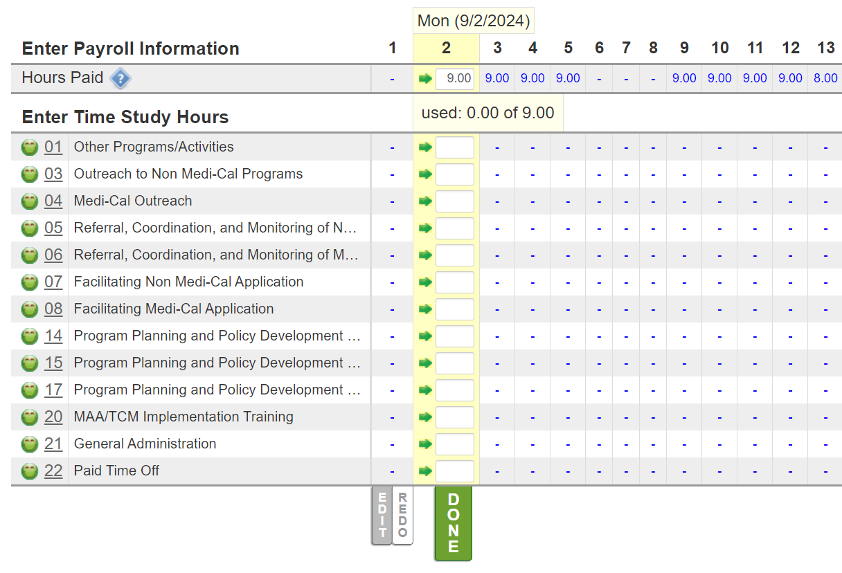
COVID-19
Time Study Process
Sample Electronic Time Study System
CACVSO- CMAA Program Overview I 8
Notes:
(Debbie)

Slide 9





INVOICE
TIME STUDY
EXPENSE
MEDI-CAL %
REVENUE
ANNUAL INVOICING
by quarter
*Minus % retained by County for administrative costs + State Annual Participation Fee
CMAA Program Overview I 9
Notes:
(Debbie) The MAA invoice is calculated using the time survey results, your claim units Medi-Cal % which is found using the client list from the quarter this is sent to the state who gives us a % of your client population for the quarter that are on Medi-Cal and your operating expenses. Can also use countywide average Medi-Cal rate if you can’t share client names or the percent of clients who have Medi-Cal is lower than your county’s average Medi-Cal rate.
Currently claiming units are $8-30k per quarter. Depends on the effort you put in. Invoices are paid by the state.

Slide 10
REVENUE
Revenue Description | Non Offset, CP 2, or CP 3
State Veterans Affairs – Vets License Plate Fund | Non Offset
State Veterans Affairs – Medi-Cal Cost Avoidance | CP 2
State Veterans Affairs – Vets Subvention | Non Offset
State Other - MHSA | Non Offset
Fed Medicaid – CMAA reimbursements | Non Offset
Miscellaneous Revenues | CP 3
Transfers in General Fund Allocation | Non Offset
Per CMAA Operational Plan page 54 provided by DHCS “Certain revenues must be offset against allocated costs in order to reduce the total amount of LGA costs that are eligible for reimbursement by the federal government. Revenue offsets include federal funds and State/local matches of federal funds that have directly or indirectly funded costs that may not be claimed for reimbursement. If a participant’s direct costs are completely funded by unallowable federal funds, they will not participate in CMAA. However, if a participant’s direct costs are only partially federally funded, the costs that are federally funded must be offset.”
MAA Program Overview I 10
Notes:
(Debbie)

Slide 11
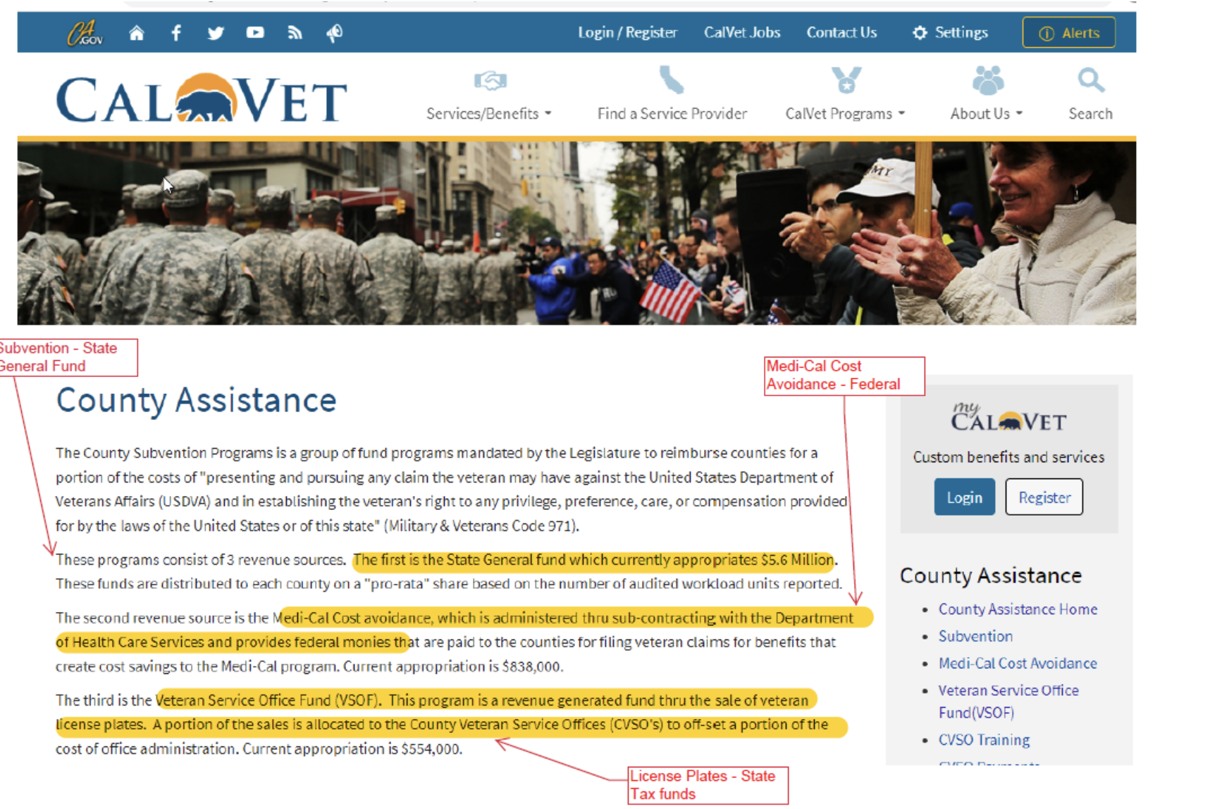
REVENUE
CMAA Program Overview I 11
Notes:
(Debbie)

Slide 12
CMAA Performance – Small County VSO
CMAA Program Overview I 12
Notes:
(Debbie) Currently, claiming unit earning $17-28,000k per quarter. Has 2-3 staff regularly time studying and 1 supervisor (can invoice for supervisors and/or support staff w/o them time studying if everyone else in the unit time studies). Reimbursement amount depends on how staff time study. About a 1.5-2 year delay in getting paid by the state.

Slide 13
CMAA Performance – Medium County VSO
* Estimated
CMAA Program Overview I 13
Notes:
(Kristal) – Started in FY 22/23, just starting to receive payments

Slide 14
Questions?
CMAA Program Overview I 14
Notes:
If you are interested in pursing CMAA, Talk to you County’s LGA Coordinator for the MAA program. If you don’t know who it is in your County, please feel free to reach out to me or Debbie and we can direct you to that person.
We would be happy to meet with you & your LGA coordinator and provide technical assistance.

